Slide 1
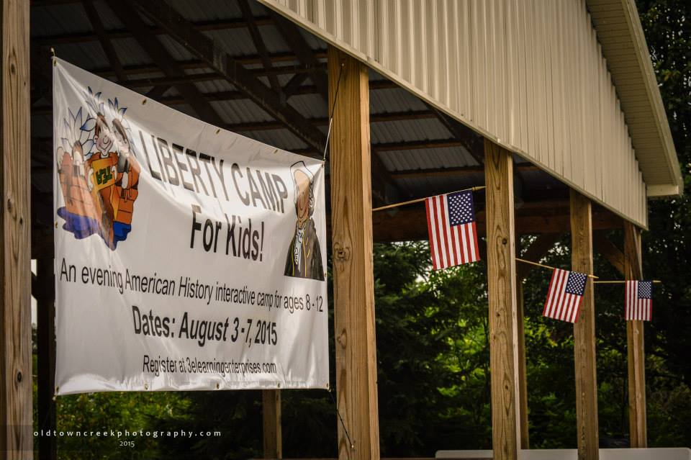

Slide 2
Welcome to Liberty Camp
● Similar format to Vacation Bible School
● Immerse children in a week of colonial life
● Teach a Biblical Worldview rather than a secular worldview (creation rather than evolution)
● Teach The American View

Slide 3
Where Do I Start?
● Prayerful consideration
God is your most important partner
● Select a steering committee
Frequency and location of meetings
Large enough to generate ideas and creativity
Small enough to easily reach consensus
10 – 12 seems to be a good size
Can add people as you identify skills needed
Not all volunteers need to be on steering committee
Network – “Who do you know who_______?”

Slide 4
Where Do I Start?
● Key Positions
Camp Director
Assistant or Co-Director
Secretary
Treasurer
Registration
Publicity
Fundraising
Station Leaders

Slide 5
Where Do I Start?
● Additional volunteers – add as you go
Governors
Snacks
First Aid
Activities / Games
Characters
Costumes / Seamstresses
Photographer / Videographer

Slide 6
Lay The Foundation
● Sponsoring organization
Tea Party, 9-12, Liberty Group
Church
Civic organization
Historical Society or group
Sponsor lends credibility and can help with funding

Slide 7

Lay The Foundation

Slide 8
Lay The Foundation
● Set dates and times for camp
Morning / Afternoon / Evening
● Select a venue
Indoor / Outdoor / Combination
Restroom facilities
Shelter for inclement weather
Electricity
Supply storage
Sound system / other A/V needs

Slide 9
Lay The Foundation
● Liability Insurance
● Background checks for volunteers

Slide 10
Lay The Foundation
● Fundraising
CVA
Civic groups
Politicians
Local businesses
Wallbuilders
Monetary and in-kind
● Recognition of Donors

Slide 11
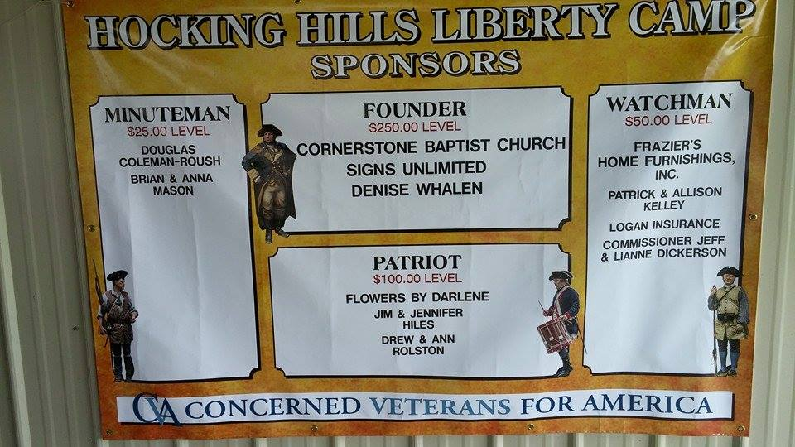
Lay The Foundation

Slide 12
Lay The Foundation
● Publicity
Social Media
Website
Updates, donor button, registration,
Email
Facebook
Phone number – Google Voice is free
Flyers – post in businesses, library, etc.
Newspaper – feature stories are free, paid ad
Television & Radio
Homeschool Networks
Churches
Word of mouth / Networking

Slide 13
Lay The Foundation
● Registration
Age limit for campers
Maximum number of campers
Deadline for registration
● Registration Forms
Liberty Camp promo flyer
Letter from Camp Director
Overview of Daily Activities
Registration Form
Waiver of Liability
Photo Release Form
Liberty Camp Rules
Picnic RSVP

Slide 14
Lay The Foundation
● Camp Fees
Investment reduces no shows
Parents pay large sums for sports camps and
other activities
$15 per child / $5 for additional children in family
Discount for children whose parents volunteer
Scholarships

Slide 15
Curriculum Resources
● Constitutional Champions Foundation
The Patriot Camp Handbook $16.00
www.constitutionalchampions.org
www.the912-project.com/constitutionalchampions
● Ivory Notebook
Vacation Liberty School Curriculum
Exploring Black Patriots
www.ivorynotebook.com

Slide 16
Curriculum Resources
● Wallbuilders
Barton’s Founders’ Bible
Posters
Posters of original documents
Coloring book
● Institute on the Constitution
● Sons of the American Revolution – local chapters
www.ohssar.org

Slide 17
Opening Ceremony
● 6:15-6:30 Patriotic Music
● Opening begins at 6:30
Prayer
Pledge of Allegiance
National Anthem

Slide 18
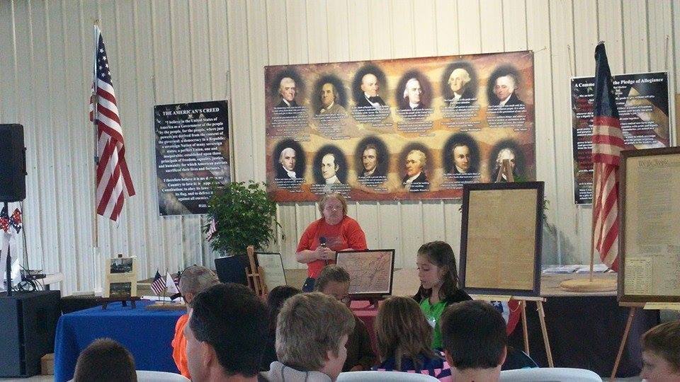
Opening Ceremony

Slide 19
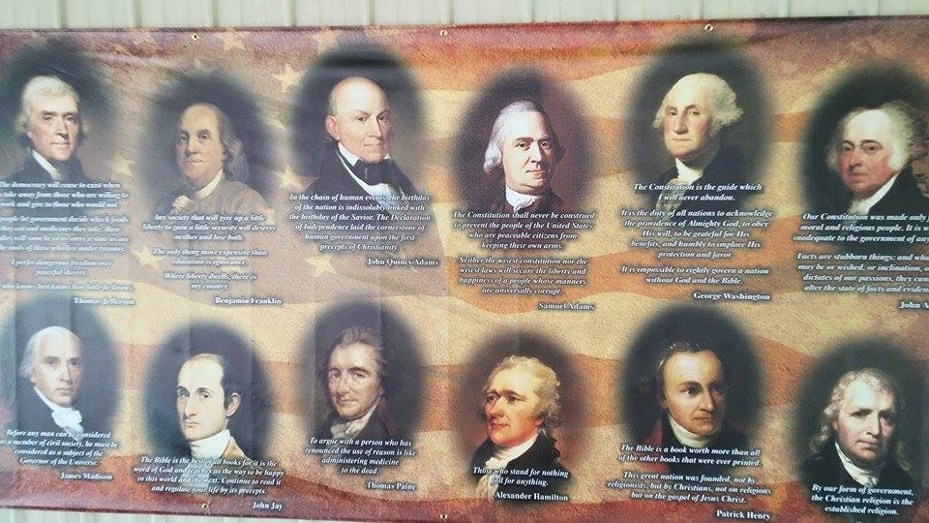
Opening Ceremony

Slide 20
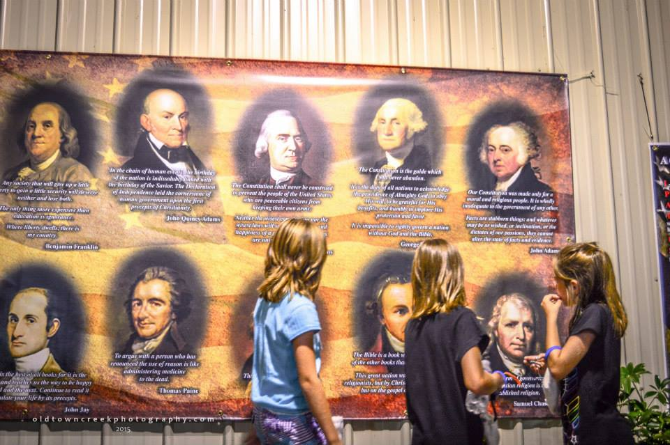
Opening Ceremony

Slide 21
Opening Ceremony
● Monday
Assigned to groups – red, white, blue
Meet Governors
Receive name tags, wrist bands, coin pouches
Silicone wristbands – no latex
Allergies & important info on back of name tag

Slide 22
Opening Ceremony
● Tuesday
Folding of the flag
Meaning of each fold
www.aflag.com/folding

Slide 23
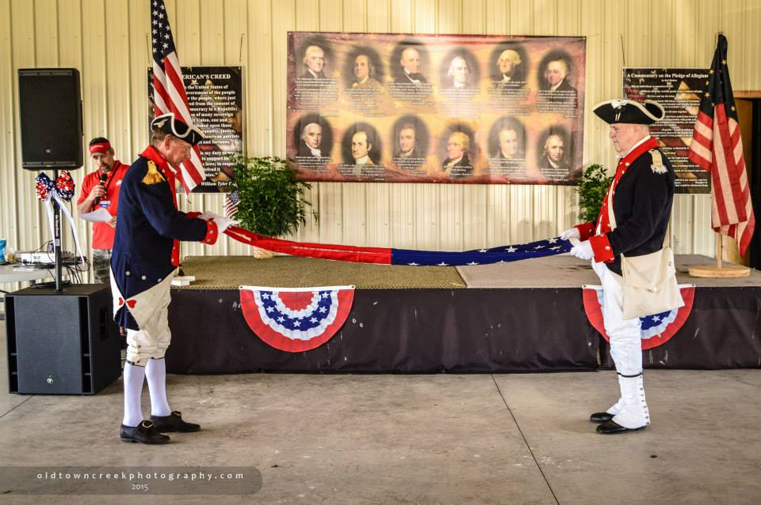
Opening Ceremony

Slide 24
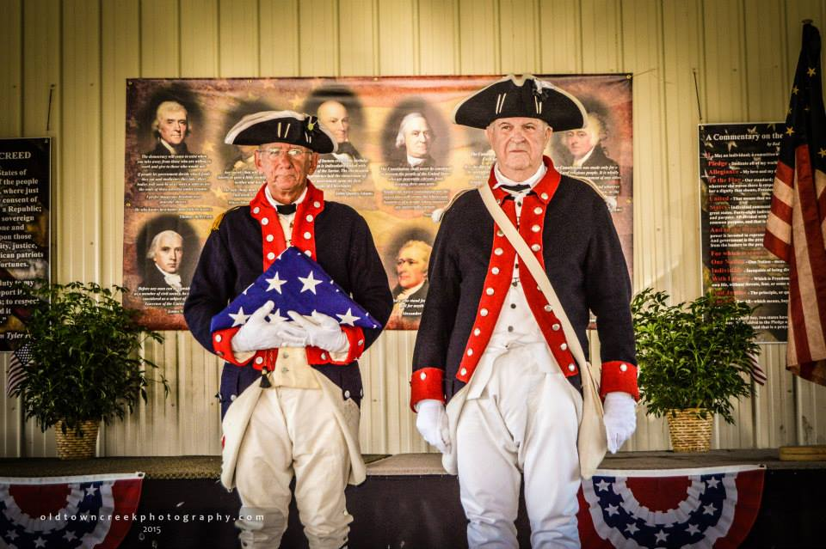
Opening Ceremony

Slide 25
Opening Ceremony
● Wednesday
Presentation of Colors

Slide 26
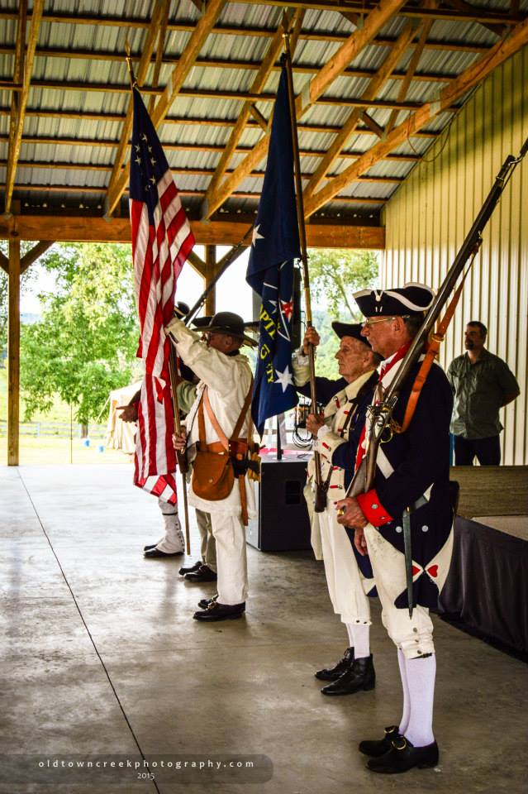
Opening Ceremony

Slide 27
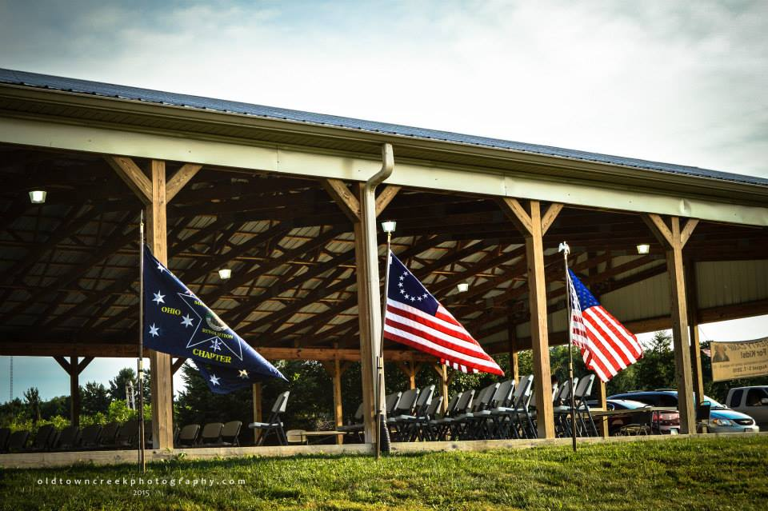
Opening Ceremony

Slide 28
Opening Ceremony
● Thursday
History and verses to Star Spangled Banner
● Friday
No special activity

Slide 29
Daily Schedule
● Monday through Thursday
Learning Station by group – 20 minutes
Activity – all groups – 20 minutes
Learning Station by group – 20 minutes
Snack – all groups – 20 minutes
Learning Station by group – 20 minutes
Closing- all groups
5 minute transition between activities

Slide 30
A Theme For Each Day
● Monday Colonial Life
● Tuesday The Rebellion
● Wednesday The Revolution
● Thursday The Constitution
● Friday Family Night

Slide 31
Monday – Colonial Life
● Learning Stations
Magna Carta
Jamestown Colony
The Pilgrims
● Activity
Grinding corn
Making Butter
● Snack
Cornbread with butter
Lemonade
● Children begin earning gold coins

Slide 32
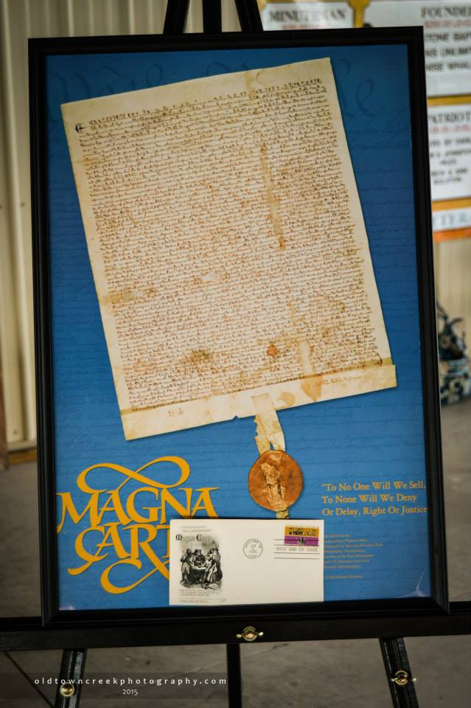
Monday – Colonial Life

Slide 33
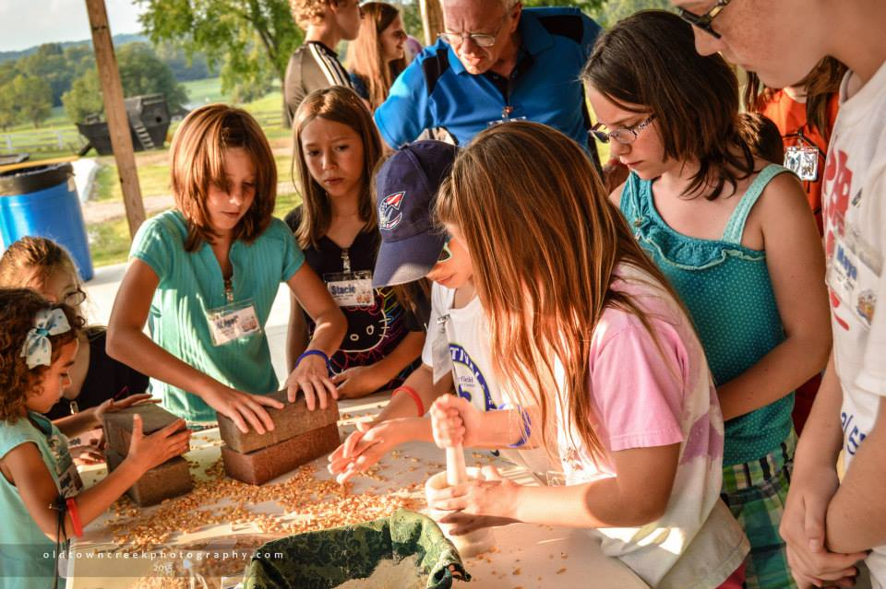
Monday – Colonial Life

Slide 34
Tuesday – The Rebellion
● Learning Stations
Peter Muhlenberg
The Boston Massacre & Boston Tea Party
John Dye
● Activity
Boston Tea Party
● Snack
Oatmeal Cookies
Iced Tea
Make root beer

Slide 35
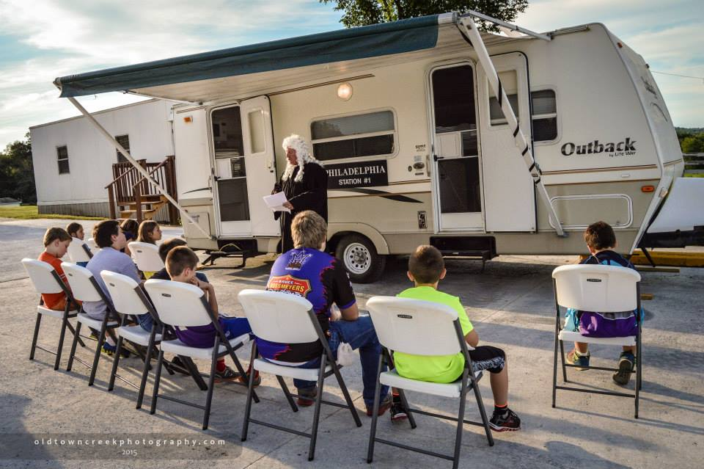
Tuesday – The Rebellion

Slide 36
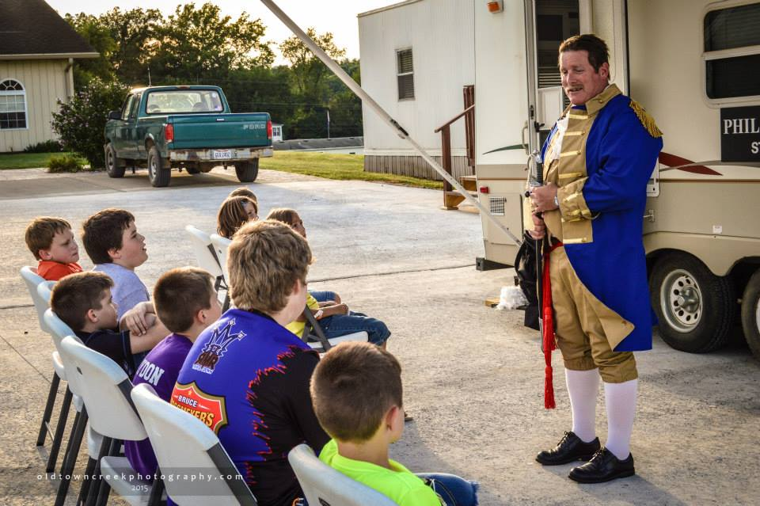
Tuesday – The Rebellion

Slide 37
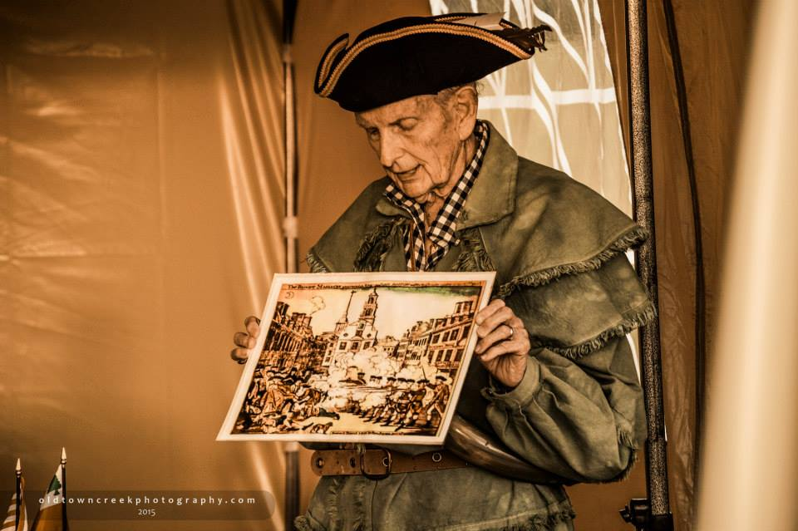
Tuesday – The Rebellion

Slide 38
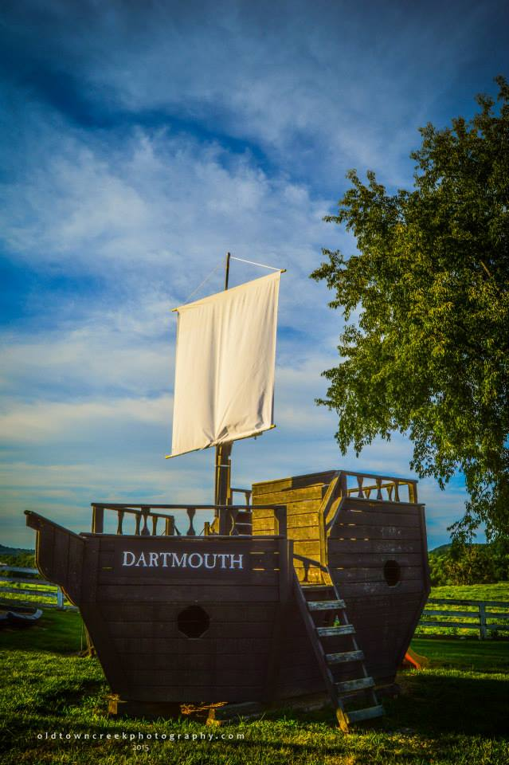
Tuesday – The Rebellion

Slide 39
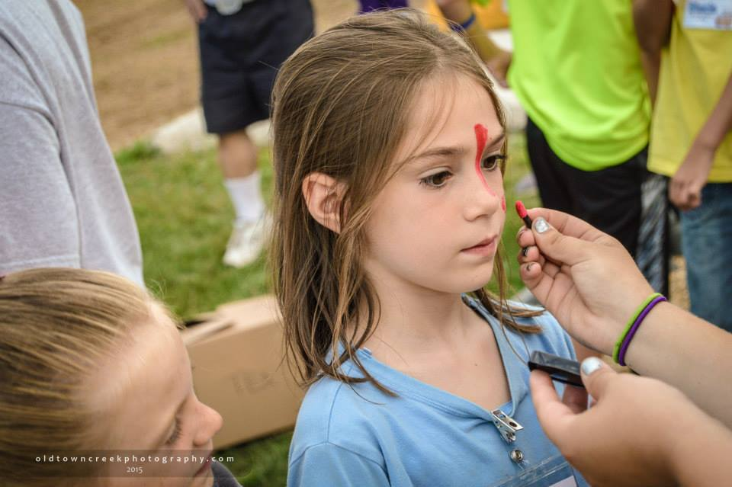
Tuesday – The Rebellion

Slide 40
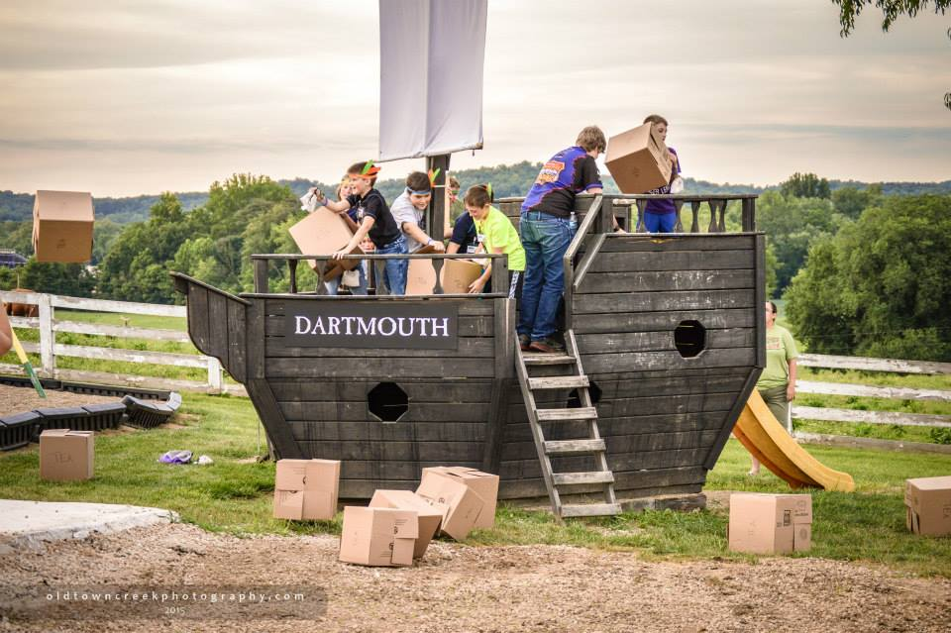
Tuesday – The Rebellion

Slide 41
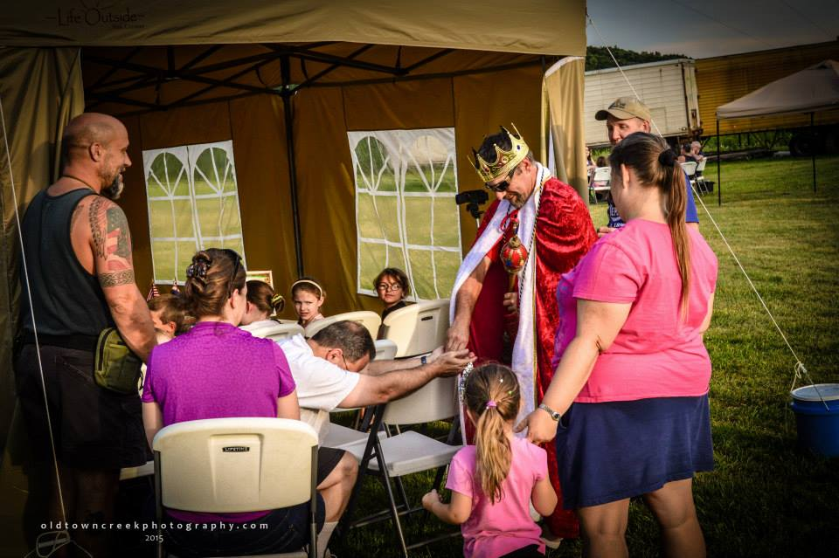
Tuesday – The Rebellion

Slide 42
Wednesday – The Revolution
● Learning Stations
Valley Forge / Foxy Hollow / Continental Army
Militia
Mr. Dye
● Activity
Valley Forge
● Snacks
Pretzels
Root beer
Story of the Gadsden Flag

Slide 43
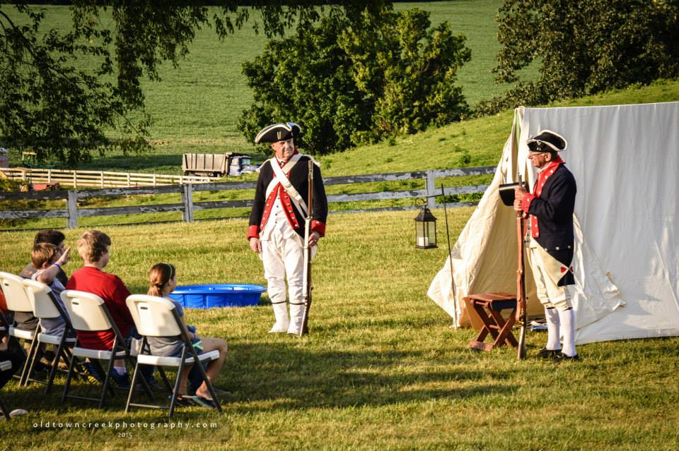
Wednesday – The Revolution

Slide 44
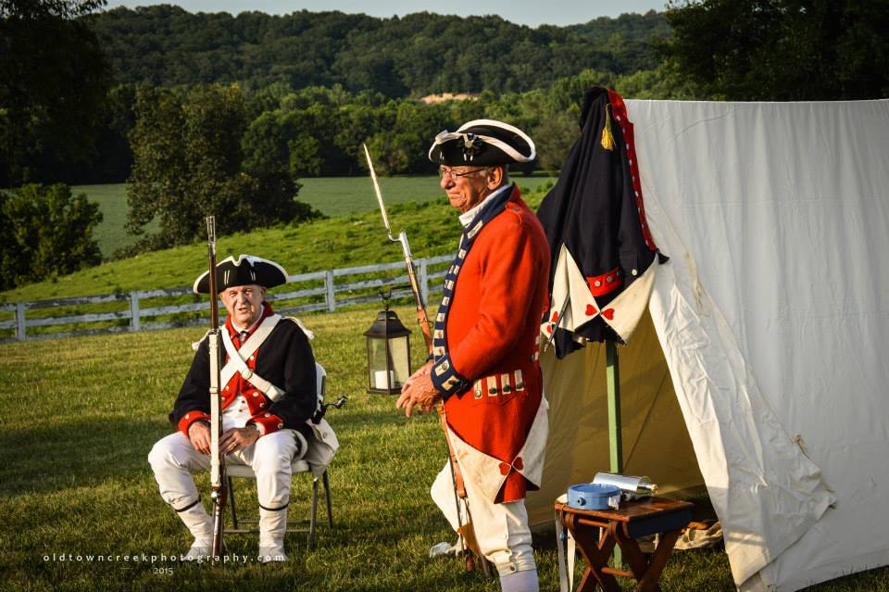
Wednesday – The Revolution

Slide 45
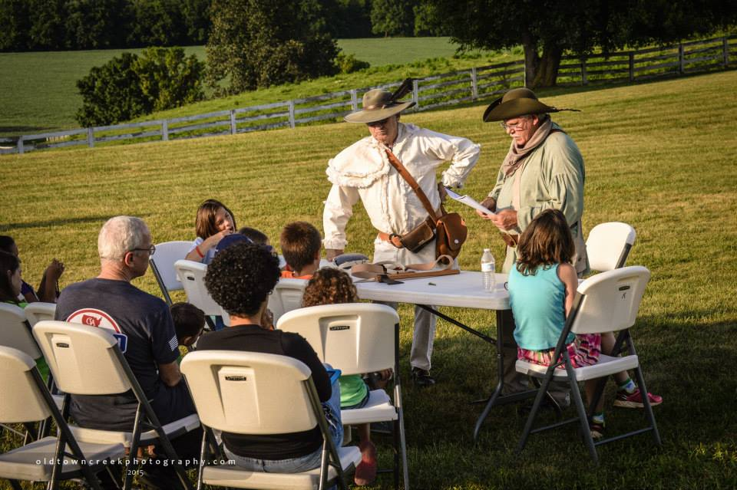
Wednesday - The Revolution

Slide 46
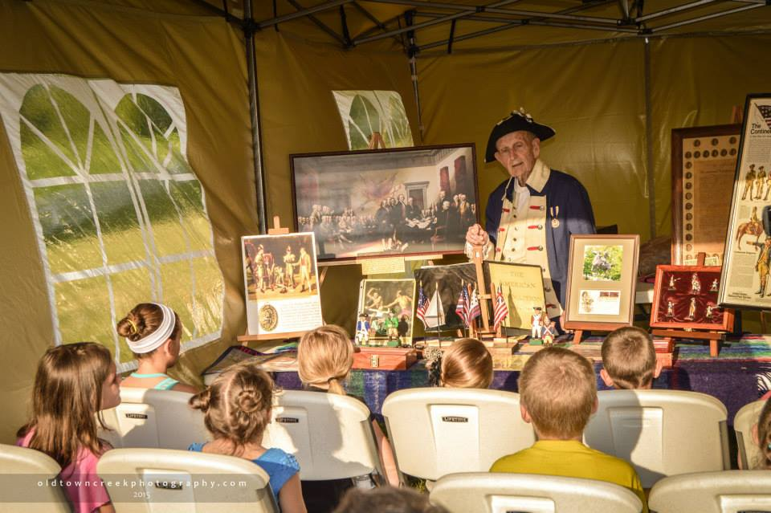
Wednesday – The Revolution

Slide 47
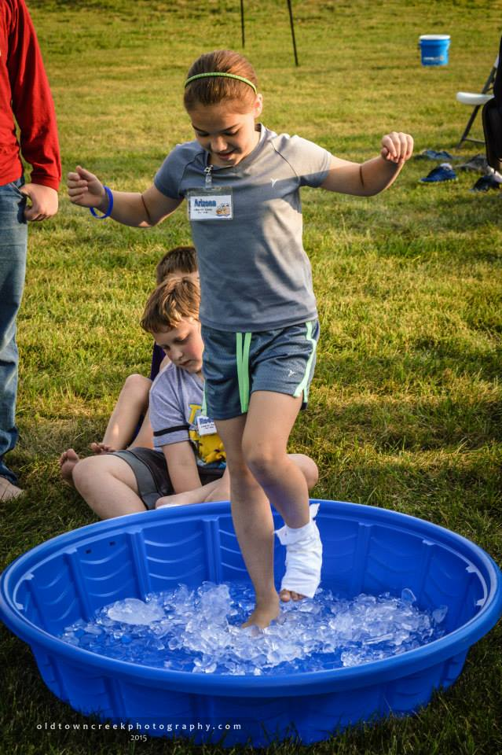
Wednesday – The Revolution

Slide 48
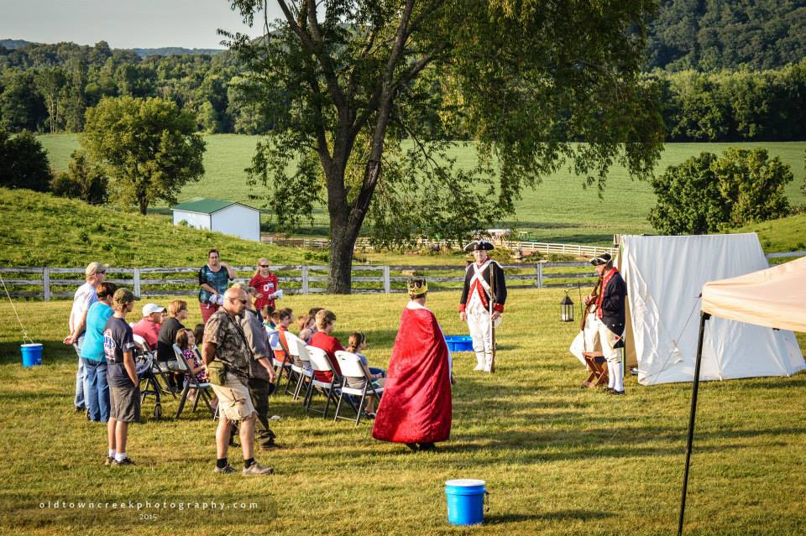
Wednesday – The Revolution

Slide 49
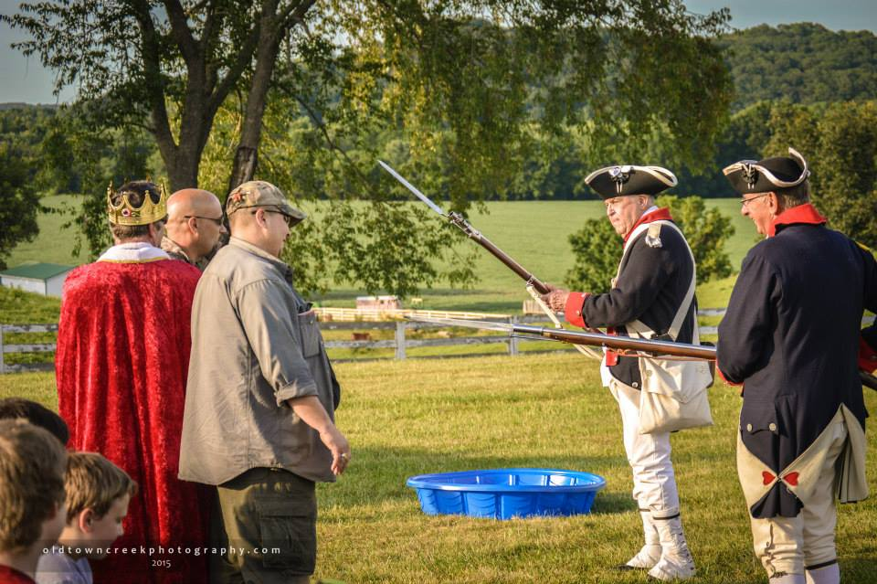
Wednesday – The Revolution

Slide 50
Thursday – The Constitution
● Learning Stations
Elizabeth Baker – Ancestor’s Story
Mr. Dye
The Constitution
● Activity
Tootsie Roll Tax
● Snack
Patriotic freeze pops

Slide 51
Daily Closing
● Governors collect:
Wrist bands
Name tags
Coin pouches
● Prayer
● Sign out

Slide 52
Friday – Family Night
● Opening
● Picnic
● Declaration of Independence
The American View
Baking soda and vinegar demonstration
Campers use quill pens to sign their own DOI
● Patriot Dodge Ball
● Liberty Store
● Bags and notebooks given to each camper
● Camper evaluation

Slide 53
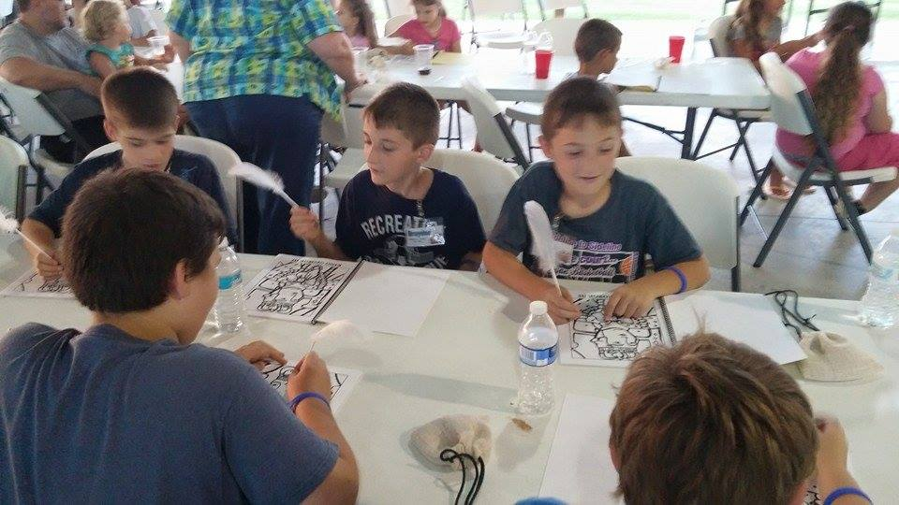
Friday – Family Night

Slide 54
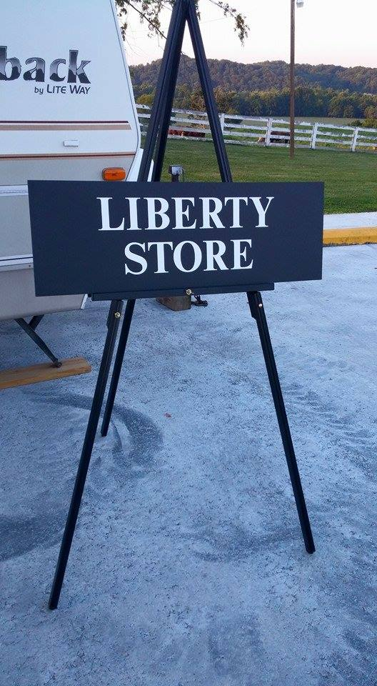
Friday – Family Night

Slide 55
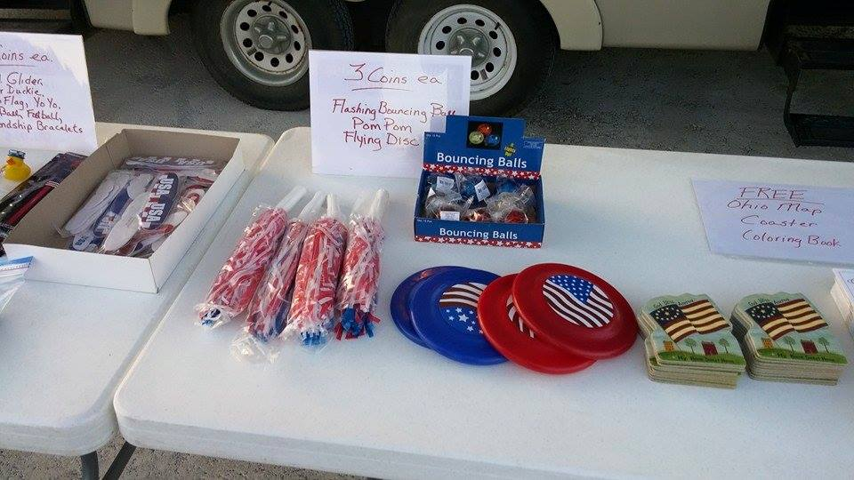
Friday – Family Night

Slide 56
